Slide 1
CES 361
Fundamentals of Software Testing
Session 12

Slide 2



Assembling a Test Plan
So far, we have talked about:
What are they?
Is this all we need?
Why or why not?
Boundaries & Equivalence Classes
What are they?
If this is more rigorous,
then why use the first?
Pairwise Testing & Orthogonal Arrays
What is it?
Why would we do it?
When is it a good idea?
Decision Table Testing
Which component of
these test cases might
be harder to set up?
Stress, Load & Performance Testing
When can we use it?
When can’t we use it?
Use Case Scenario Testing
What is happening
down in this corner?
Test Case ∂
No Preconditions
Input: ß = 19.4 œ = 2.718
Expected Output: 42
Actual Output: ____
Pass __ Fail __
Reason:
Test Case ∂
No Preconditions
Input: ß = 19.4 œ = 2.718
Expected Output: 42
Actual Output: ____
Pass __ Fail __
Reason:
Is this our test plan?

Slide 3

Assembling a Test Plan
Which test cases make the final roster?
How many “final rosters” are there?
What factors influence this decision?
What is the ultimate goal?
How does this affect your project?
>>Image of KC Chiefs removed<<

Slide 4
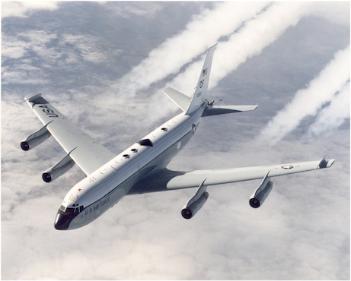
Creating a Test Plan

Slide 5
HW 4
Pass ‘em in...

Slide 6
This slide intentionally left blank

